Slide 1
Developing Tools to Help Your Consortium Fund Data-driven Strategies
Dulce Delgadillo, M.P.P. Janeth Manjarrez, M.S.,P.P.S.
Jason Makabali Harpreet Uppal, Ph.D.
CAEP Summit
October 27, 2020

Slide 2
Agenda
01. Introduction/
NOCRC
02. NOCRC Resource Allocation Process for CAEP Program Areas
03. Proposal Templates/Rubric
04. Evaluation Plan
05. Closing
Notes:
Proposal: NOCRC and NOCE’s research office developed a template and rubric for a data-driven resource allocation process. The tool emphasizes the inclusion of data collection efforts and alignment to CAEP metrics during the planning phase. This allows researchers to work with actionable data to help examine the effectiveness of CAEP funded strategies. This presentation will discuss the process in which these tools were developed and implemented.

Slide 3
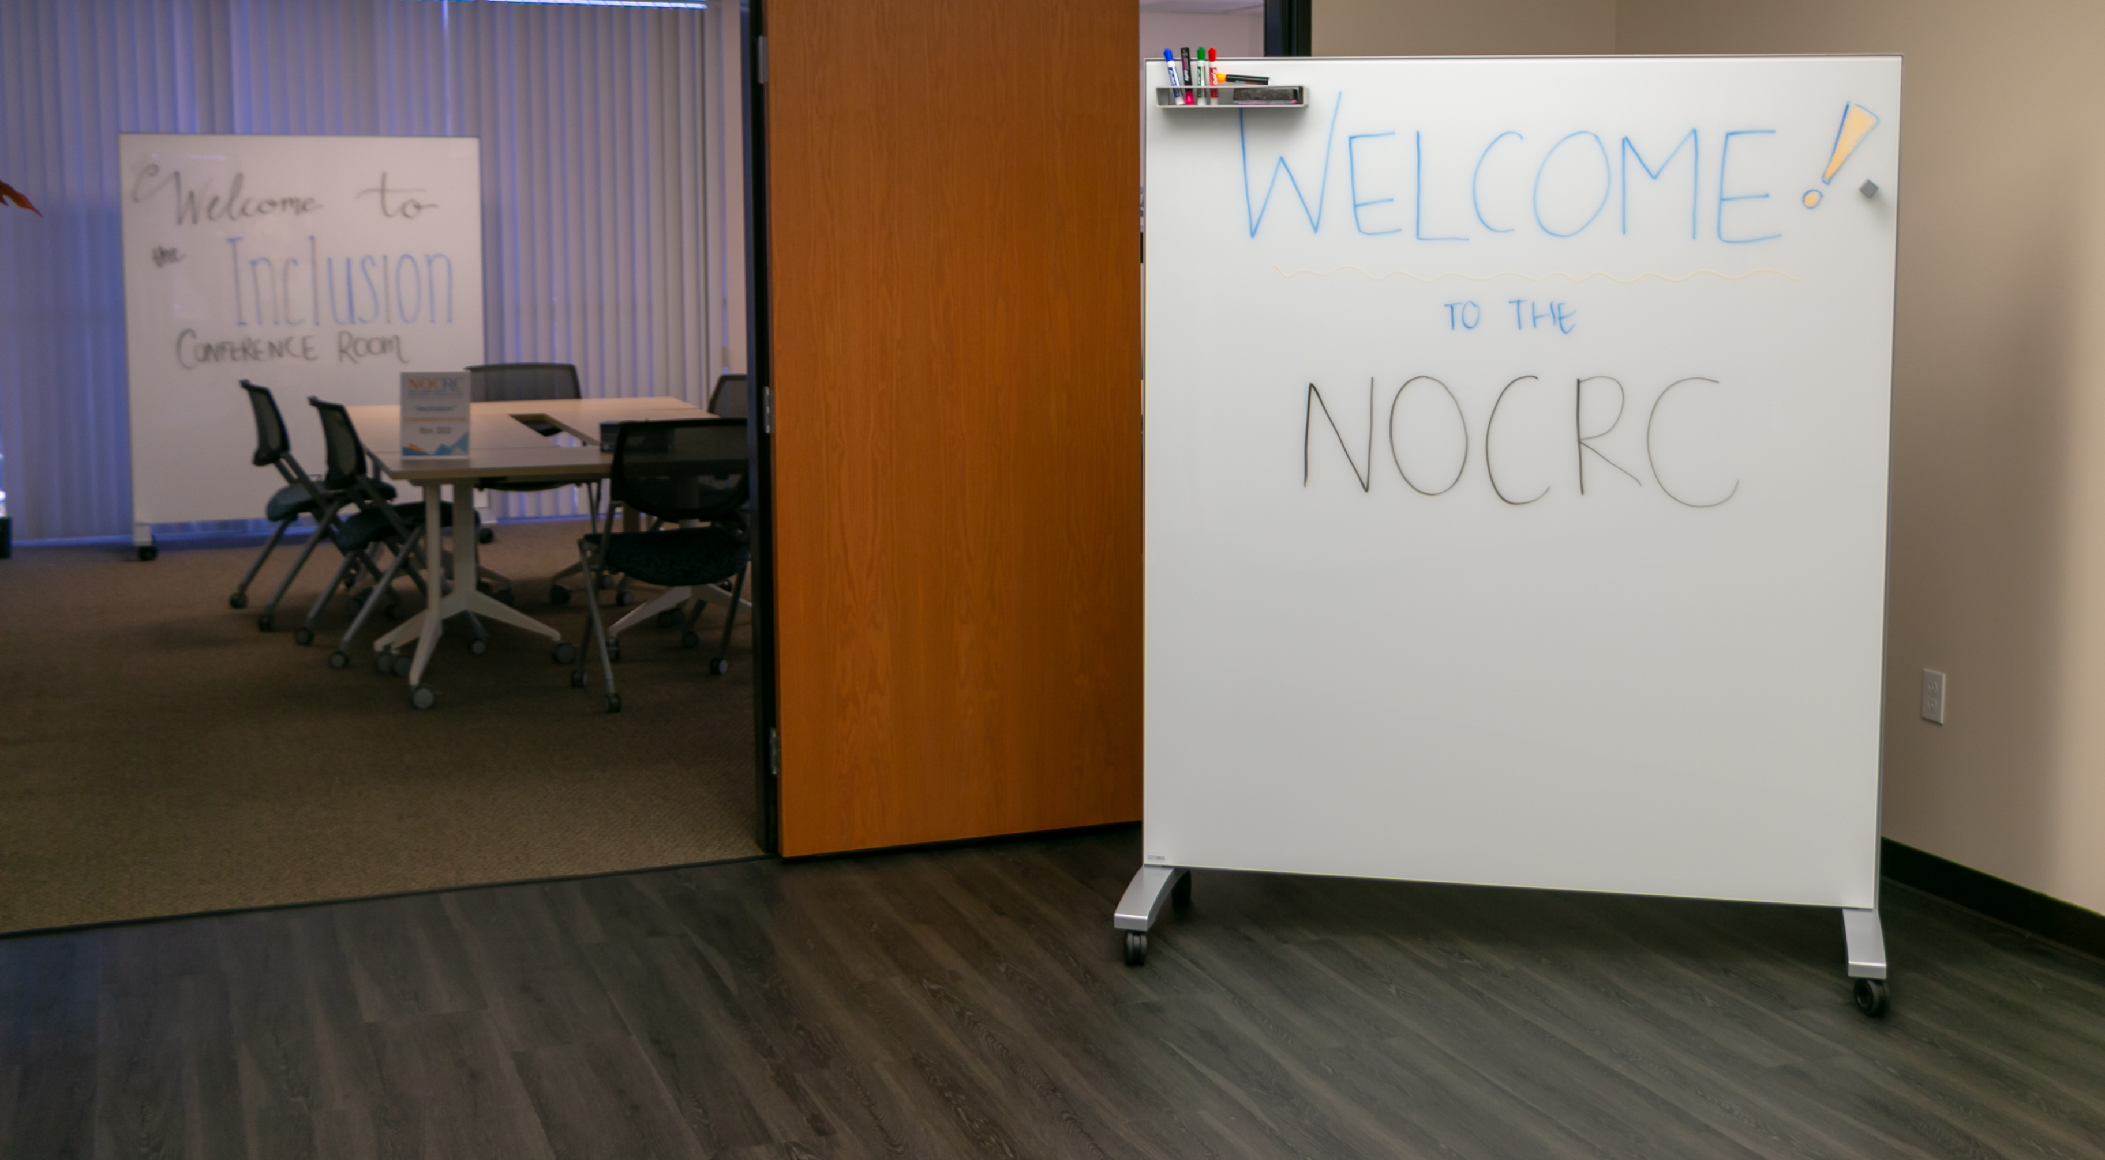
North Orange County Regional Consortium
How does NOCRC function?
Who are our adult education providers?
Role of Regional Partners
Workgroups
Notes:
Janeth

Slide 4
NOCRC Resource Allocation Process for CAEP Program Areas
Current tools used to determine resource allocation for CAEP strategies/activities
Connecting CAEP outcomes to existing decision-making processes for CAEP strategies/activities
Decision to revamp CAEP strategies/activities proposal templates and scoring rubric
Notes:
Janeth

Slide 5
Let’s take a poll!
Does your consortium have a resource allocation model/process?
ⓘ Start presenting to display the poll results on this slide.
Notes:
Dulce

Slide 6
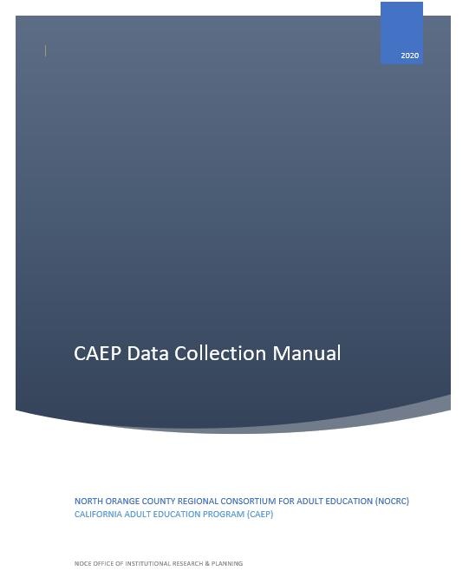
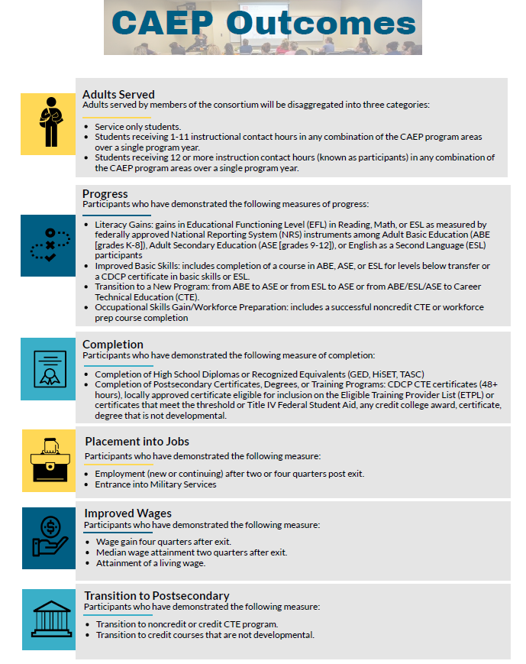
Goals
Inclusion of data collection efforts
Alignment to CAEP metrics
Notes:
Dulce

Slide 7
Strategy Proposal Template
Notes:
Dulce

Slide 8
Proposal Criterion: Background and Significance
Identify the problem to be addressed and the needs to be met by the strategy/program. Describe the proposed project and how it will enhance the community. Include any relevant research and/or data that is relevant to support the proposed strategy/program.
Questions to consider: Who is the target population? What gaps are you trying to address/close through the implementation of your proposed strategy/program?
Why We Asked?
Community Needs
Notes:
Dulce

Slide 9
Proposal Criterion: Regionally Inclusive
Describe how your proposal incorporates consortium members/partners throughout the region. Describe any existing regional partnerships, ongoing relationship building and/or communication efforts involved.
Questions to consider: How will the project include partnership and visibility with community partners? What partnerships are being built and/or strengthened through the implementation of the proposed strategy/program?
Why We Asked?
Leveraging Partnerships
Notes:
Dulce

Slide 10
Proposal Criterion: Goals, Objectives, and Milestones
Describe the desired goals and the overall impact of the program. Describe the strategy objectives in measurable terms that address the needs discussed above.
Questions to consider: What are the goals of the proposed strategy/program? How do you intend to achieve those goals?
Why We Asked?
Know your goals
Need to know what to measure
Notes:
Dulce

Slide 11
Proposal Criterion: Implementation Plan
Describe in bullet form the specific implementation plan for the proposed strategy the Workgroup will employ to improve services in the program area(s) beginning the 2020-21 school year. Describe your program activities, staffing, partners, timelines and explain how the program will enable you to address the problem or need.
Questions to consider: What is the timeline for implementation and impact? Are there any possible barriers and challenges that may impact this timeline and implementation?
Why We Asked?
What are you doing?
How are you doing it?
Notes:
Dulce

Slide 12
Proposal Criterion: Data Collection Plan
Describe who will collect the data, where/how it will be stored, and how it will be reported and utilized for your proposed strategy/program. Describe any methodologies for self-improvement through the support of data.
Questions to consider: How will you measure expected outcomes and the effectiveness of your program? What tools will you use to evaluate your program (student records, surveys, interviews, pre- and post-test, etc.)? How will evaluation help your program?
Why We Asked?
Data shouldn't be an afterthought.
Notes:
Jason

Slide 13
Proposal Criterion: Alignment with CAEP Metrics
Provide an explanation of which CAEP outcomes this strategy will help achieve.
Questions to consider: Which CAEP outcome metrics will your proposed strategy/program help the consortium meet?
Why We Asked?
State Requirement
Notes:
Jason

Slide 14
Proposal Criterion: Scalable
Specify your plans for institutionalizing the proposed strategy/program.
Questions to consider: How do you plan to institutionalize the proposed strategy/program? What possible barriers and challenges do you foresee in the effort to institutionalize?
Why We Asked?
If it is working, expand on it.
Notes:
Jason

Slide 15
Let’s take a poll!
Has your consortium utilized in any manner logic models for implementation of activities/services?
ⓘ Start presenting to display the poll results on this slide.
Notes:
Jason

Slide 16
Logic Model
Notes:
Jason

Slide 17
Proposal Scoring Rubric
Notes:
Jason

Slide 18
Notes:
Jason

Slide 19
Notes:
Jason

Slide 20
Let’s take a poll!
Does your consortium have any type of evaluation plan to assess the consortium activities?
ⓘ Start presenting to display the poll results on this slide.
Notes:
Harpreet

Slide 21
Evaluation Plan
Notes:
Harpreet

Slide 22
Evaluation Plan
Notes:
Harpreet

Slide 23
Notes:
Harpreet

Slide 24
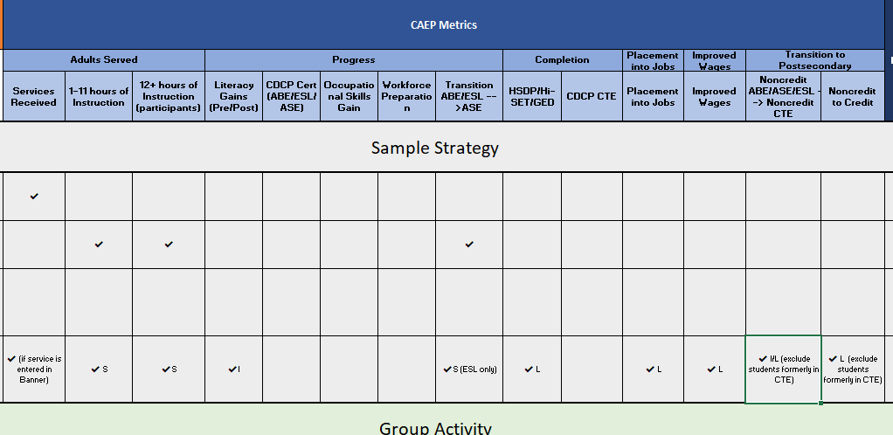
Notes:
Harpreet

Slide 25
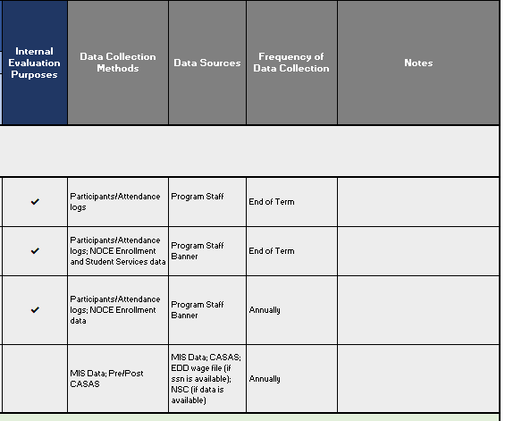
Notes:
Harpreet

Slide 26
Evaluation Report
Notes:
Harpreet

Slide 27
Notes:
Harpreet

Slide 28
Timeline
January 2019
Oct 2019- Oct 2020
OIRP developed a manual to streamline data collection
Ongoing data conversations at the beginning of the implementation and at the end of the academic year
June 2019
October 2020
Begin mapping strategies/activities metrics and CAEP outcomes
Completion of the first CAEP NOCRC Evaluation Report
Notes:
Harpreet

Slide 29
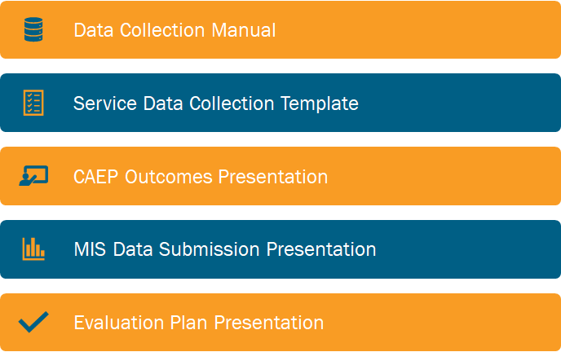
Additional Tools
Notes:
Harpreet

Slide 30
Lessons Learned
Identification of Strategy Objective(s)
Knowing what you want to do is essential to knowing what you want to evaluate
Data Shouldn't be an Afterthought
Talk about Data at the Development Phase
Technical Assistance
Data familiarity
Notes:
Harpreet

Slide 31
Notes:
Harpreet

Slide 32
Contact Information
Dulce Delgadillo
Janeth Manjarrez
ddelgadillo@noce.edu
jmanjarrez@noce.edu
Jason Makabali
Harpreet Uppal
jmakabali@noce.edu
huppal@noce.edu

